Slide 1
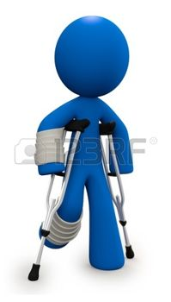
Mechanical trauma 2 Dr Nirmala Perera
Fractures
incised wounds
stab injuries
Injury description
2016

Slide 2
Objectives
Define fracture/incision/stab injury
Identify fracture/incision/stab injury by their features
Describe these injuries for medico legal purposes
Interpret features of causative weapons
Interpret circumstances of causation of above injuries

Slide 3

Fractures

Slide 4
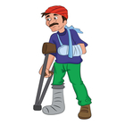
Fractures
A destruction to the continuity of the bone
Fractures are caused by direct blunt force trauma or indirect transmission of blunt force trauma
Fractures are grievous injuries.

Slide 5
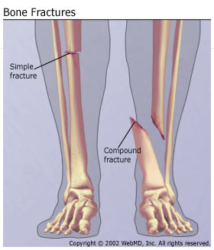
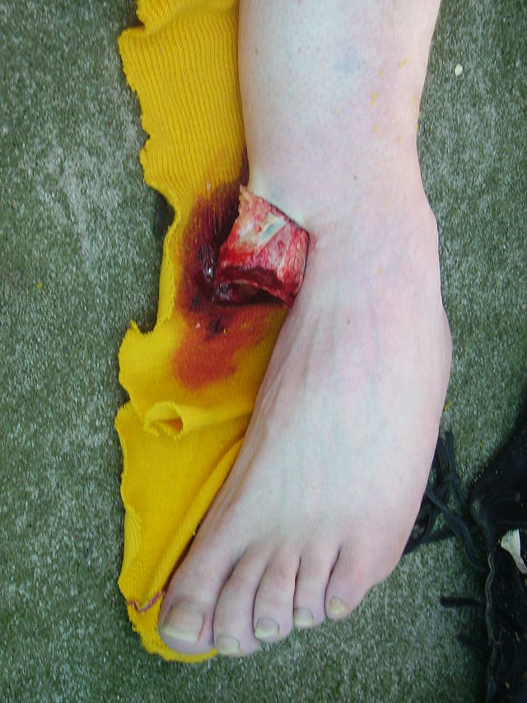
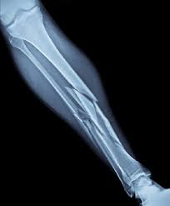
Description of fractures
Open/compound fracture
Fracture exposed to exterior
Simple/closed fracture
overlying skin is intact
Comminuted fracture
Having several fragments

Slide 6
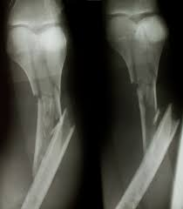
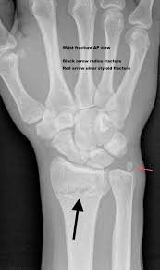
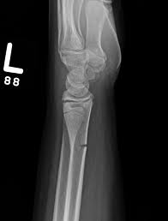
Description of fractures
Displaced fracture
loss of bone alignment along its long axis.
Non displaced fracture
Bone alignment remains
Greenstick fracture
the bone partly fractures on one side

Slide 7
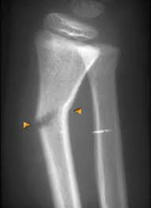
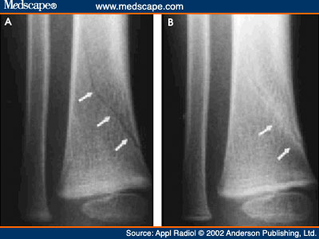
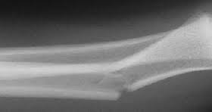
Description of fractures-direction
Transverse fracture
A fracture that is at a right angle to the bone's long axis.
Oblique fracture
A fracture that is diagonal to a bone's long axis.
Spiral fracture
at least one part of the bone has been twisted.

Slide 8
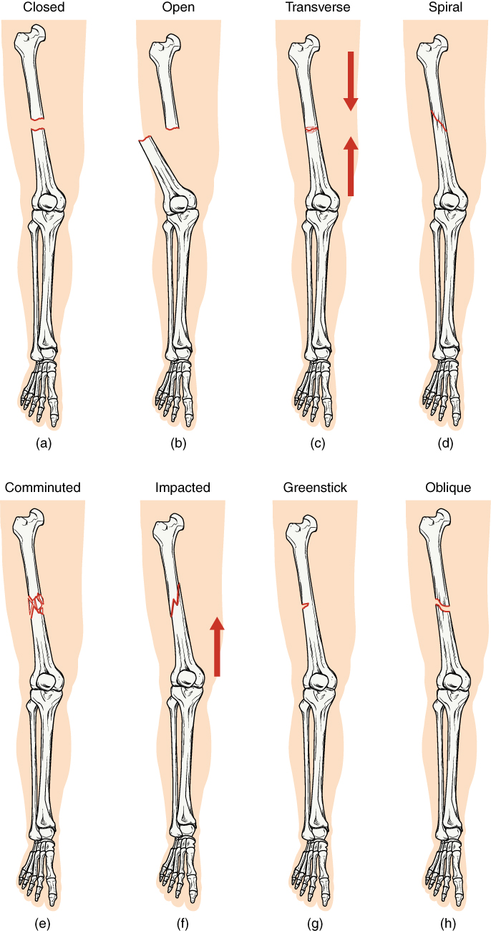
Description of fractures

Slide 9
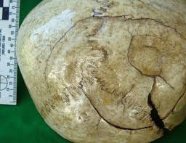
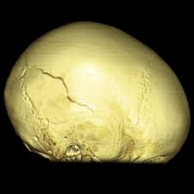
Description of fractures-shape
Linear fractures
fracture lines that are undisplaced and linear
Depressed fractures
Pieces of bone driven in
Cob web fracture

Slide 10
Description of fractures-shape
Hinge fractures
Ring fractures

Slide 11

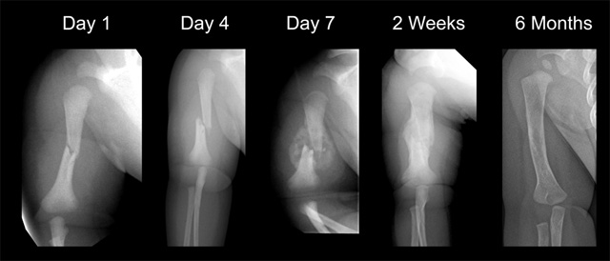
Dating of fractures
Callus formation
Remodeling
Healed fracture

Slide 12
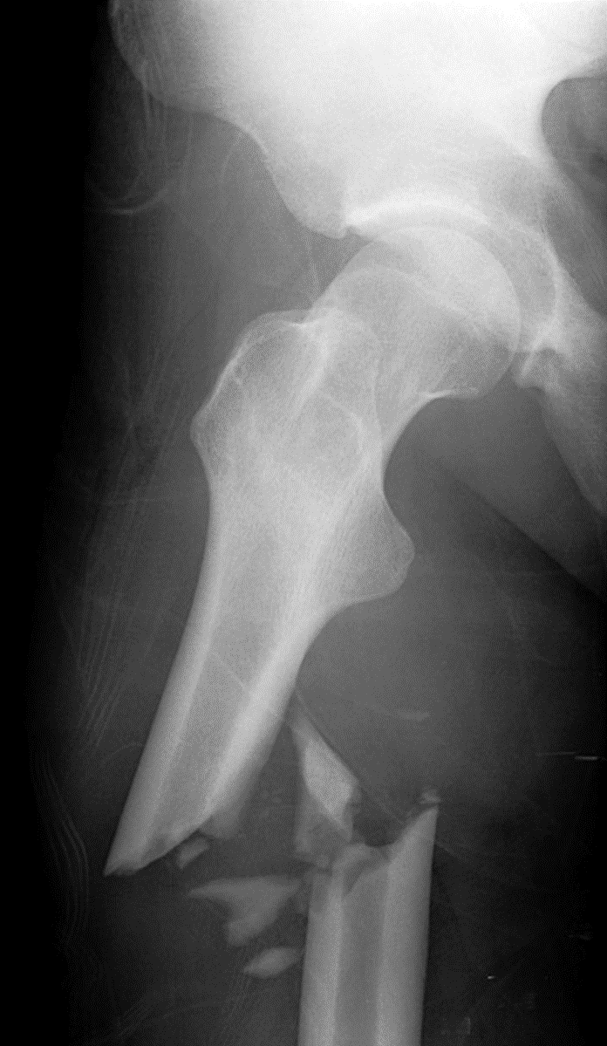
Describe this fracture

Slide 13
Describe this fracture
Site –Right femur, upper 1/3
Obliquely placed
Compound
Comminuted
Displaced
Recent fracture

Slide 14
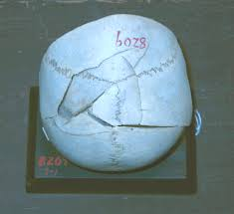
Circumstances of causation of fractures
Child abuse
Accident
Fall
Assault

Slide 15
Causative weapon of a fracture
Cut injury- heavy, sharp cutting weapon
Cut injury- Triangular striking surface

Slide 16
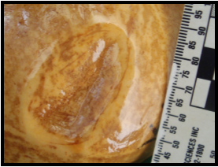
Causative weapon of a fracture
Depressed fracture-
Blunt,heavy circular striking surface
Depressed fracture –
Blunt,heavy elongated weapon

Slide 17
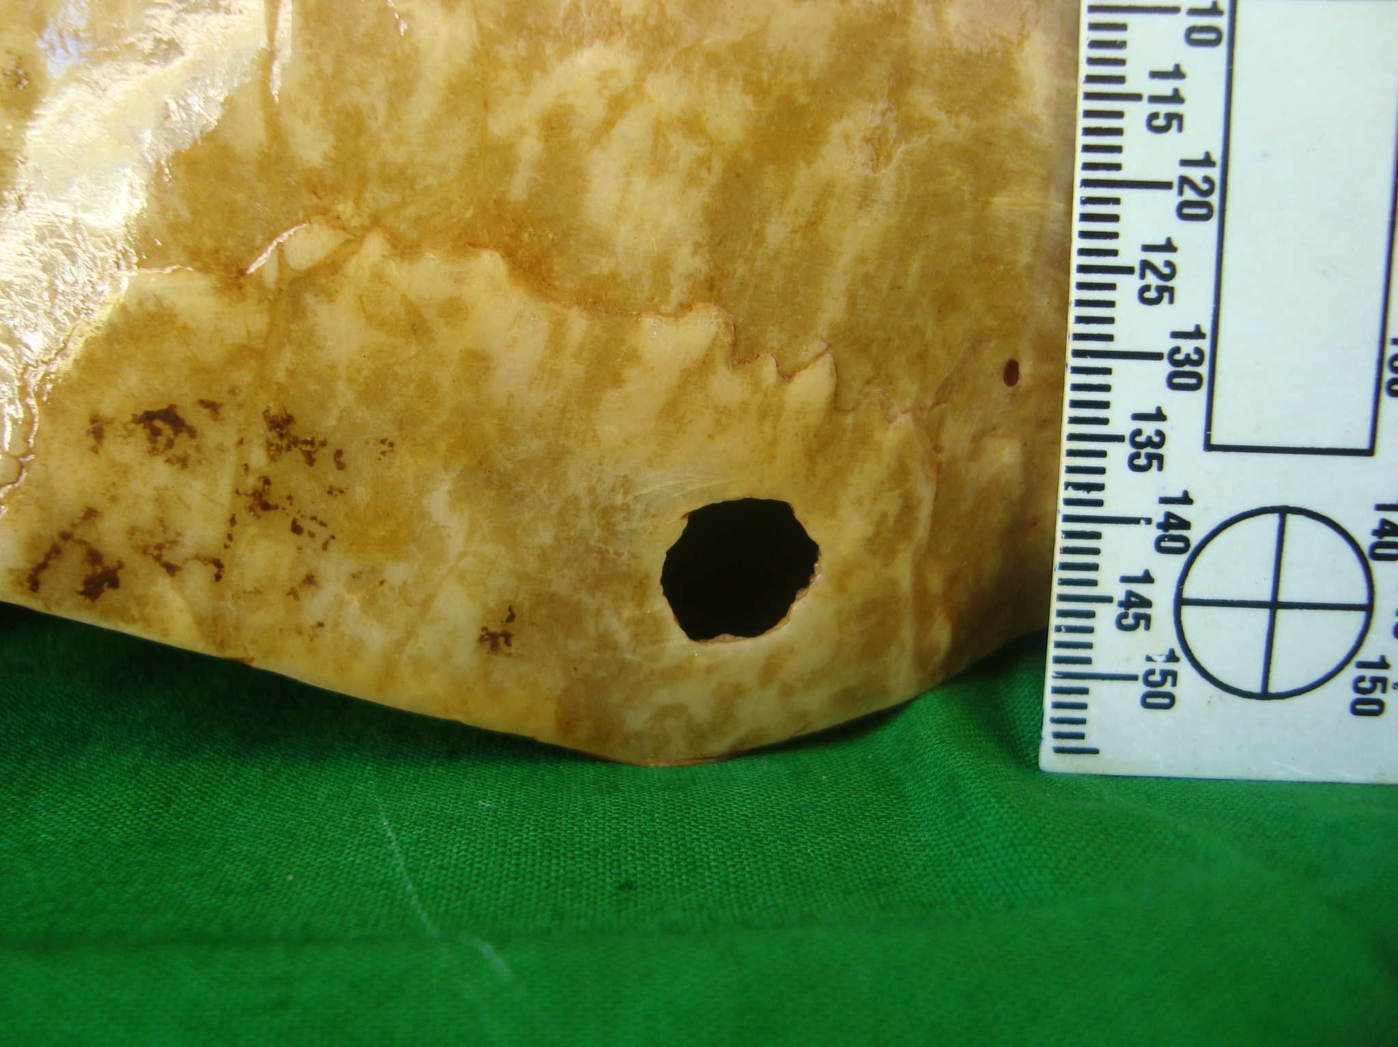
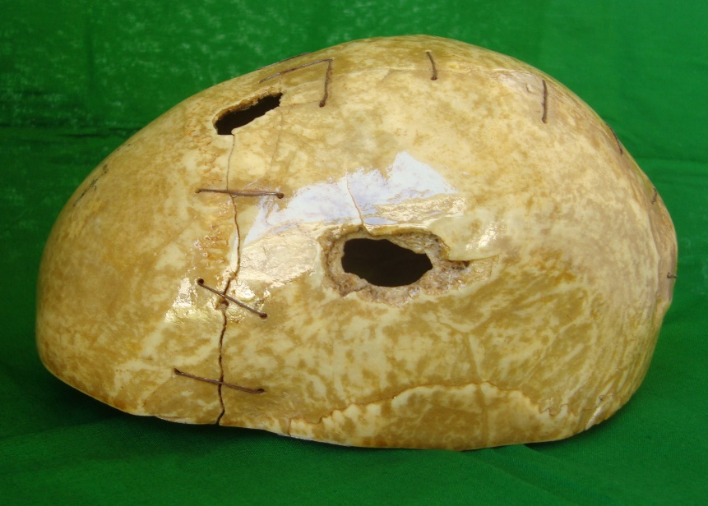
Causative weapon of a fracture
Circular bony deficiency- Firearm entry
Outer beveling –Firearm
exit

Slide 18
Medico legal significance of fractures
Identification of causative agent/weapon
Interpretation of possible internal and external injuries (skull fractures)
Category of hurt
Amount of force used to cause this injury
Event reconstruction
Dating of injury

Slide 19
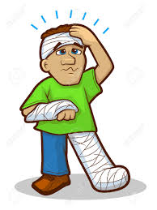
Sharp force trauma
Incised wounds
stab injuries

Slide 20
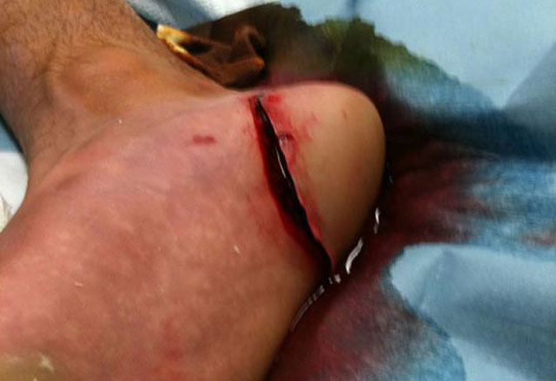
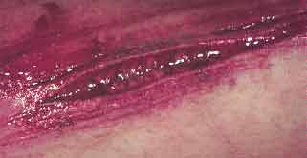
Incised wounds
Discontinuity of skin or tissue caused by sharp cutting weapon. Length of the injury is grater than the depth.

Slide 21
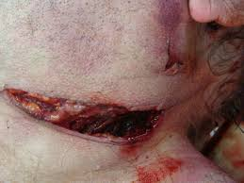
Characteristic features
Length of the injury is grater than the depth.
Margins are cleanly cut.

Slide 22
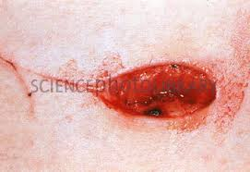
Characteristic features
Ends are sharp, tailing effect is seen.
Presence of “tailing” indicate path of the withdrawal of weapon

Slide 23
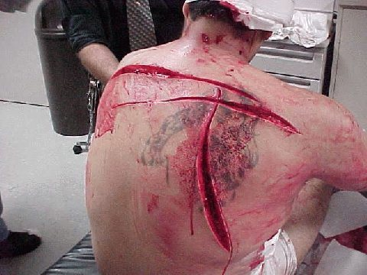
Characteristic features
Depth is more at the commencement of injury
Underline tissues are evenly cut.

Slide 24
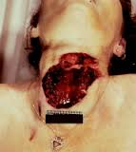
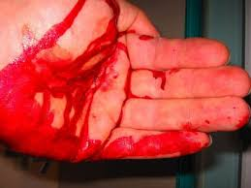
Characteristic features
Gape widely
Bleed profusely

Slide 25
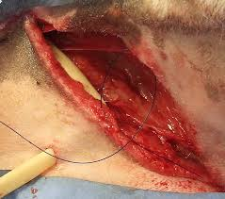
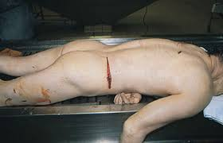
Features of weapon determine the appearance of the injury
sword
kitchen knife
Heaviness of the blade
Sharpness of the blade

Slide 26
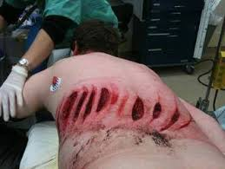
Features of weapon determine the appearance of the injury
Axe
Sword
Thickness of the blade
Minimal Length of the blade

Slide 27
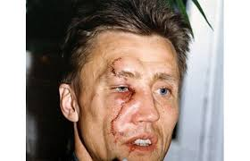
Features of weapon determine the appearance of the injury
Glass pieces
Irregular injuries

Slide 28
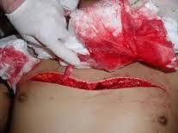
Slash cuts
Sharp edged weapon moving in an arc causes slash cuts.

Slide 29

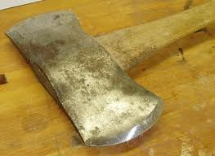
Chop wounds
Heavy weapons with cutting edge such as axe causes chop wounds
There will be underlying bone injury

Slide 30
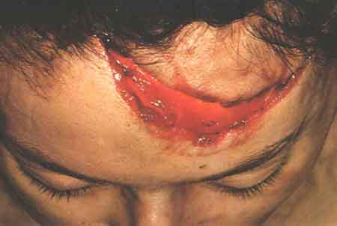
How do you differentiate cut injury from a laceration ?

Slide 31
Lacerations vs cut injury
Lacerations | Cut injury
Margins irregular | Margins are sharply cut
Tissue bridging present | No tissue bridging
Floor is uneven | Floor is even
Less bleeding | Bleed profusely
Hair bulbs crushed | Hair bulbs are cut
Lacerations | Cut injury
Margins irregular | Margins are sharply cut
Tissue bridging present | No tissue bridging
Floor is uneven | Floor is even
Less bleeding | Bleed profusely
Hair bulbs crushed | Hair bulbs are cut

Slide 32
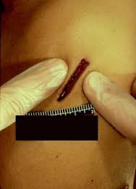
Stab injuries
Those are caused by the sharp cutting weapon, depth of the injury is grater than the length.

Slide 33
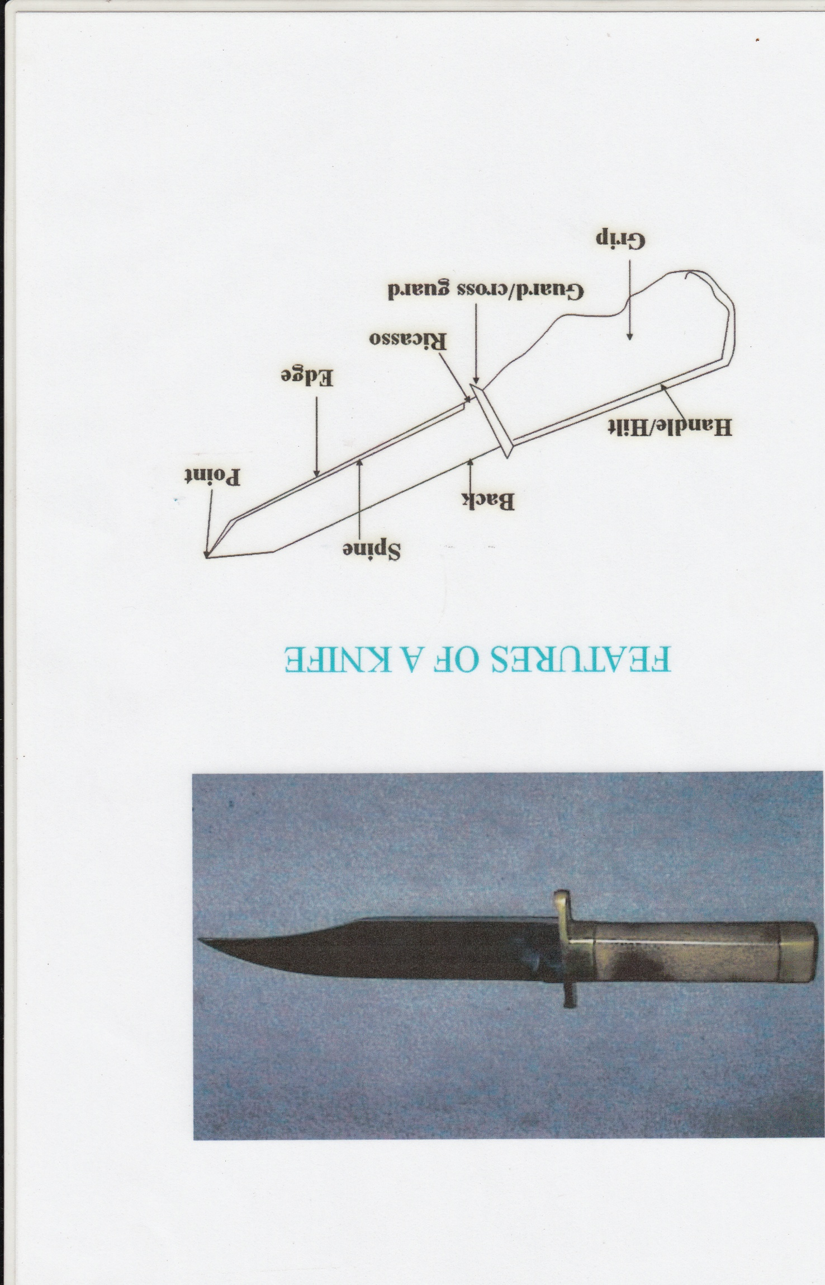

Features of the weapon

Slide 34
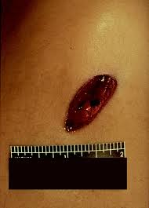
Shape of the stab injury
Pointed, thin bladed,
one cutting edge
Both side cutting
Linear stab injuries
Acute end and blunt end
Elliptical

Slide 35
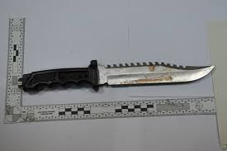
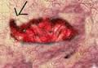
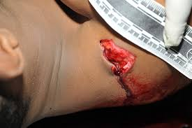
Shape of the stab injury
One edge thick and blunt
Other edge thin and sharp
Serrated knife
Fish tail
Irregular shape

Slide 36
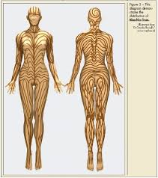
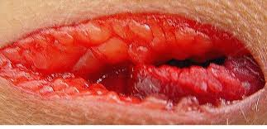
Shape of the stab injury
overhang of upper edge, bevel of lower edge
Undermine and shelving
Gaping of injury due to Langer’s lines

Slide 37
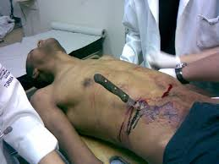
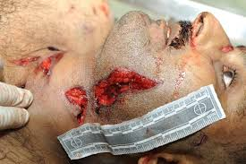
Features of the weapon
Width of the blade = external length of the injury
Length of the blade = Depth of the wound
External length of injury > rocking, angular stabs
Differ in abdomen and chest

Slide 38
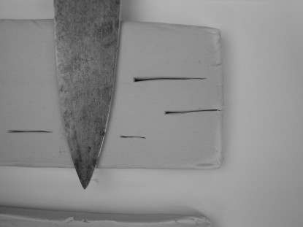
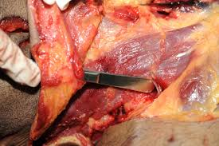
Features of the weapon
Shape of the blade
Tapering or not

Slide 39
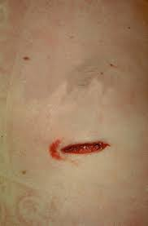
Features of the weapon
Presence of hilt mark indicate deeper penetration of knife

Slide 40
Medico legal significances of stab injuries
Interpretation of injury
Identification of weapon
Reconstruction of event
Circumstances of injury
Indication of force used
Presence of trace evidence ( piece of weapon)

Slide 41
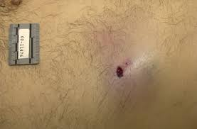
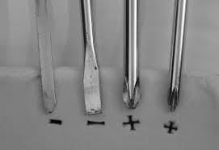
Punctured wounds
They are caused by pointed objects
Fatal injuries can be caused without leaving external marks.
Shape of the wound is changed with weapon

Slide 42

Description of injuries

Slide 43
Description of injuries
Purpose of description of injuries
To send reports to the courts
Describing injuries on the BHT

Slide 44
Nature of the injury
Abrasion
Contusion
Laceration
Cut injury
Stab injury
Fracture

Slide 45
Specific nature of injuries
Abrasion
Scratch
Imprint
Grazed

Slide 46

Description of injuries
Site
General site
Anatomical site
Size of injury
Length and width
Height from heal

Slide 47
Description of injuries
Descriptive features
Stab injury – Margins, edges
Abrasion – Scab formation
Laceration- Margins
Contusion- colour

Slide 48
Description of injuries
Shape – linear, circular, irregular
Depth- according to tissue planes
Base of the injury
Disposition/direction
Underline internal injuries
Presence of foreign material
Surgical intervention
Evidence of complications

Slide 49


Description of injuries
Draw in a diagram

Slide 50
Summery
Fractures
Incised wound
Stab injury
Description of injuries

Slide 51
Thank you

Slide 52







